Slide 1
Project Presentation
Al Ayoola

Slide 2
Analyzing user app reviews
Motivation: Understanding user feedback
Problem: Analyze user sentiment from reviews to identify key themes and improve app functionality
Notes:
The motivation for this project is to understand user feedback and to analyze user app reviews to see if we can uncover actionable insights to drive enhancements in the functionality of the app. ChatGPT IOS app was the app I was using for this.

Slide 3
LDA for user review topic grouping
Latent Dirichlet allocation (LDA) - a probabilistic model for topic modeling.
LDA Process
Initialization: Words are initially assigned to random topics.
Iteration: Words are reassigned based on topic prevalence in documents.
Topic Inference: Probabilities of word-topic associations are computed.
Topic Distribution: Final distributions of topics for documents and words for topics are obtained.
Notes:
To solve this problem, I used LDA for topic modeling to help identify key themes from the reviews. I also used sentiment analysis to be able to understand the sentiments associated with each topic.

Slide 4
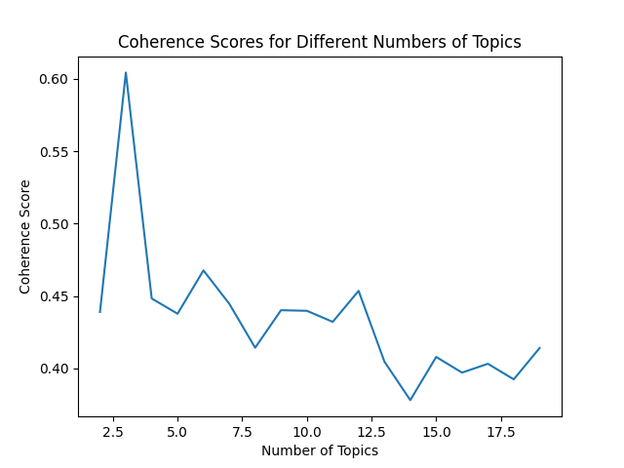
Implementation
Data preprocessing
LDA coherence score
Sentiment analysis using Textblob
Notes:
First I did data preprocessing on the app reviews (remove non-alphabetical characters, filtered out stopwords -> words that have no meaning (me, of, we). Next, I Picked the optimal number of topics to separate the reviews into using a coherence score. A coherence score is basically a measurement used to evaluate how meaningful and consistent a set of topics is. So in the context of this project, a higher coherence score for a topic means that the words in the topic are often mentioned together in the reviews and make sense when you read them as part of a group. So this helps us see identify key themes. Lastly, I used the Textblob library to tag each review with a sentiment score, so we can understand the sentiments associated with the topics and whether they are positive, negative or neutral.

Slide 5
Evaluation
Topic 1: great, good, love, ai, ios, amazing, use
Topic 2: ai, responses, experience, information, language, knowledge, conversations
Topic 3: phone, ipad, version, number, account
Sentiment | Negative | Neutral | Positive
Topic
1 | .030584 | .295644 | .673772
2 | .068966 | .334975 | .596059
3 | .181188 | .435644 | .383168
Notes:
So here are the results of the LDA topic modeling. It was kind of difficult trying to understand what actionable feedback or insights could be understood from each topic but from what I could understand, Topic 1 shows a general positive sentiment as we can see from the results (67% was positive sentiment). So in terms, of usability it seems to be doing well among users. Topic 2 also has majority positive sentiment with it’s 60% positive sentiment. Again, this it’s kind of difficult to uncover insights, but there seems to be a concern among users on the interaction with the chatgpt ai and some of the responses and interactions. Topic 3 has key themes, ‘phone’, ‘ipad’, ‘account’, so maybe something is bothering users with the functionality across different devices. Topic 3 has the most balanced sentiments out of all the topics. (38% positive, 18% negative which is the highest and 43% neutral)

Slide 6
Questions?
Notes:
I wasn’t able to use a different model to compare how it would perform against LDA, if I could do this project over again I would make sure I do this. Also, I wasn’t able to get access later version history of the chatgpt app that aligned with my dataset, so I could verify that maybe developers have addressed user concerns, this is originally what I wanted to do. That’s my project are there any questions I can answer at this time?

